Slide 1


Inorganic polymers
Geopolymers?
H. Rahier
hrahier@vub.be

Slide 2
content
Definition
Raw materials: solids
Activators
Reaction mechanism, kinetics,
First precursors: alumino silicates: the easy case
Reaction products: chemically
Properties of products
High temperature properties
Broaden to Ca containing, Fe containing: the real world
Properties of products
Environmental impact

Slide 3
Definition
Polymer =
  Large molecule
  Retains polymeric properties in solution or liquid state (high viscosity)
Inorganic
  E.g. SiO₂, window glass
  Can be crystalline or amorphous
Thus Inorganic polymers = large family!
Quid alkali activated cement? OPC? Geopolymer?

Slide 4
Alkali activated
Here restriction of inorganic polymer to
  alkali activated cements,
  at environmental temperature
  thus excludes zeolites, acidic activation, and maybe more
Activated
  Precursor activated by alkaline solution
  Solid + liquid

Slide 5
Geopolymer? Wikipedia of Davidovits
'...Geopolymers consist of a polymeric Si–O–Al framework, similar to zeolites. The main difference to zeolite is geopolymers are amorphous instead of crystalline.
'... Geopolymers are framework structures produced by condensation of tetrahedral aluminosilicate units, with alkali metal ions balancing the charge associated with tetrahedral Al.
For ceramic scientists
'...Geopolymers are a class of totally inorganic, alumino-silicate based ceramics that are charge balanced by group I oxides. They are rigid gels, which are made under relatively ambient conditions of temperature and pressure into near-net dimension bodies, and which can subsequently be converted to crystalline or glass-ceramic materials.'

Slide 6
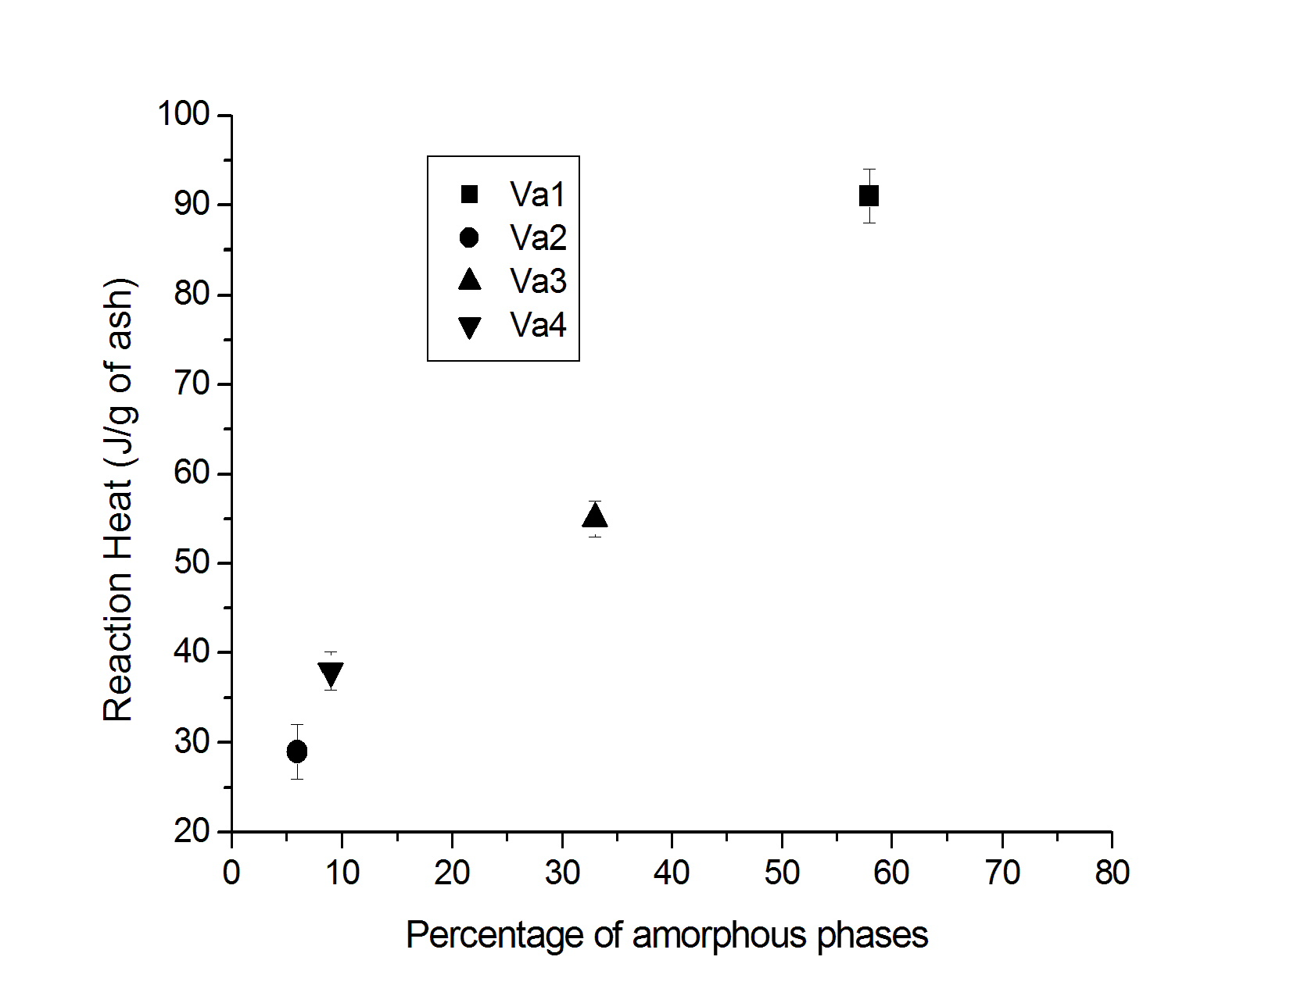
Solid precursors
Aluminosilicates, Fe-silicates,…?
  metakaolinite,
  fly ash,
  slags from metallurgy
  volcanic ash
  volcanic tuff
Amorphous = reactive
  E.g. volcanic ashes, calorimetry
  Reaction with Na-silicate
  Total amount reacted increases with amorphous fraction
  Lemougna, et al. Ceramics International, 40, (2014) p 811

Slide 7
Solid precursor
Small particles
Large particles
Particle size
  Large particles: rate determined by surface area
    Diffusion control!!!
    Thus no complete reaction
  Small particles: rate determined by polymerization
Rate (as heat flow) as a function of particle size
Isothermal calorimetry
  J. Mater Sc. 38, pp: 3131, 2003

Slide 8
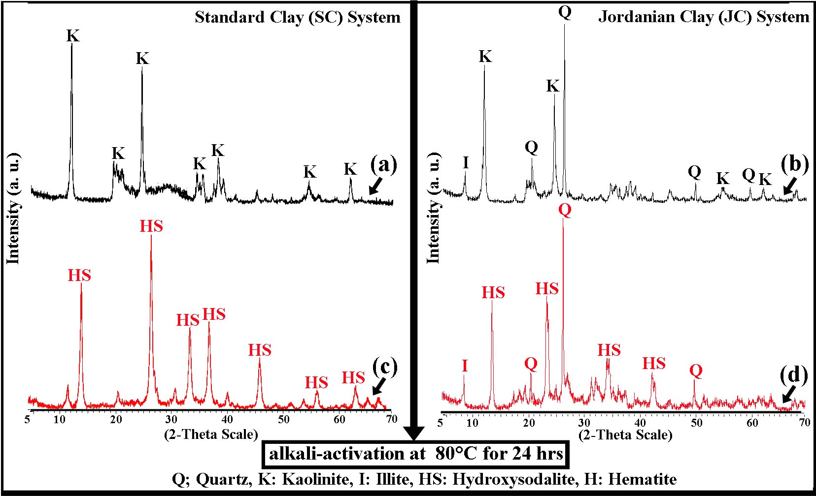
Solid precursor
Amorphous?
Kaolinite + NaOH also reacts (40°C or higher)
Forms semi crystalline product (hydroxysodalite)
Thus not geopolymer
Still inorganic polymer
XRD of kaolinite (black) and IP of kaolinite with NaOH
Construction and Building Materials. 91, p. 251 (2015

Slide 9
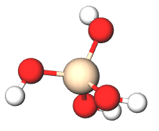
Activators
-OH or -O⁻
Classical:
  NaOH, KOH
  Na-silicate, K-silicate: Na₂O.sSiO₂.wH₂0
  s> 1 -2
  w: often depending on workability
Others
  Ca(OH)₂ + K₂CO₃ Applied Clay Science 126 p. 278 (2016)
  Biomass ashes Applied Clay Science. 119, p. 401 (2016)
Efflorescence
  Excess of Na forms carbonate
  Less problematic with K
Si

Slide 10
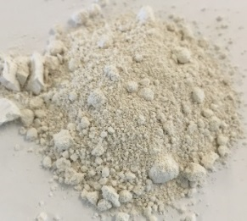
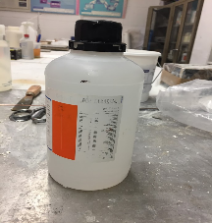
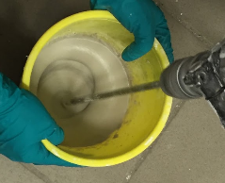
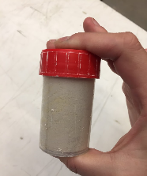
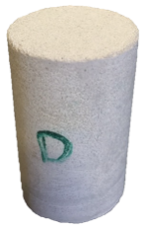
Reaction - polymerization
Metakaolinite Powder
MODEL SYSTEM
Silicate solution
mixing
&
moulding
Mix to obtain
homogenous mixture
Curing
Hardened cement paste/mortar
‘geopolymer’
*In case of mortars → Addition of quartz sand (1 MK to 3 Sand)

Slide 11

Reaction
Aluminosilicate source
During the first stage:
Dissolution of the precursor
Second stage:
Oligomers are formed and start to condensate
Concentration OH⁻ decreases, thus reactivity towards dissolution decreases
Last stage:
Polymerization
-over the formation of a gel
(stage with one network but still more liquid than solid)
-to a solid network (vitrification)
+ OH⁻ +
OH⁻
Na⁺
Aluminosilicate attacked
+ oligomers
Also containing tetrahedral Al
Polymerization
Gelation
Vitrification
IP formation
Adapted from own work and https://www.engineeringcivil.com/durability-of-flyash-based-geopolymer-concrete.html

Slide 12
Reaction mechanism
Polycondensation: Si-OH + OH-Si = Si-O-Si + H₂O
  Explains large amount of free water
  Explains large shrinkage
Difference Portland cement:
  CSH structure = hydrated Ca-silicate
  Water is chemically bound
This explains better high temp performance
  Chemistry does not change
  No large volume of vapour formed during heating

Slide 13
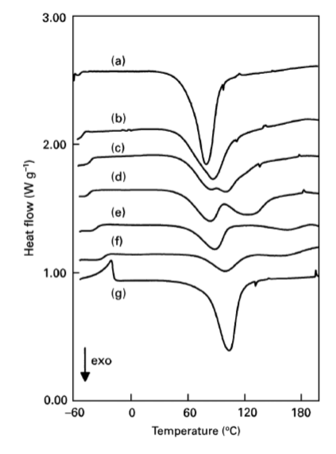
Reaction rate
Influence Si/Al
reaction
Tg silicate solution
Reaction rate (DSC, heating at 5K/min; hermetic closed pans)
Comparison of DSC thermograms for the reaction of Mk with
Na-silicate Na₂O.sSiO₂ solutions with variable s (water=10.0): s = (a) 1.0, (b) 1.4, (c) 1.6, (d) 1.7, (e) 1.9, (f ) 2.3 and (g) K-Sil with s=1.4.
K

Slide 14
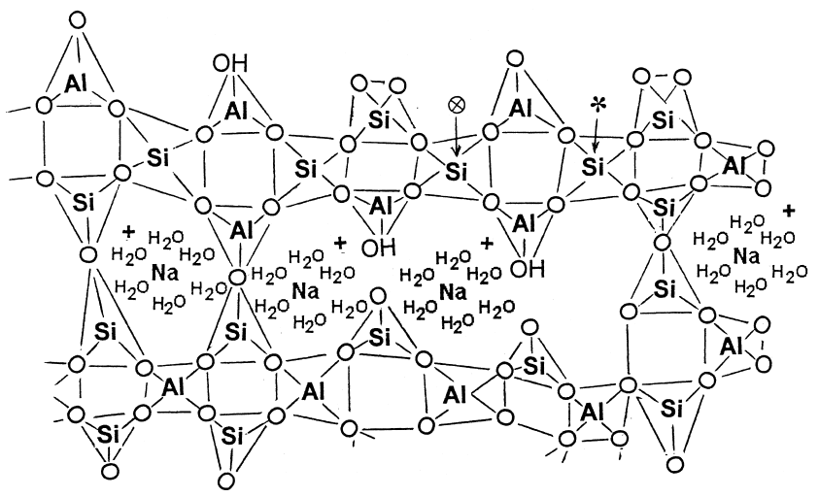
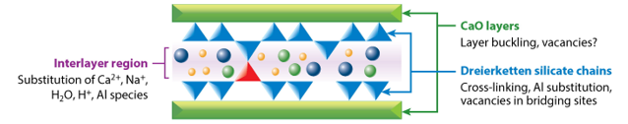
Reaction products
Molecular structure of aluminosilicates & calcium aluminosilicates
Thus ‘geopolymer’ = inorganic polymer
Provis & Bernal. (2014), Annual Review of Materials Research
Barbosa et al. (2000), International Journal of Inorganic Materials

Slide 15
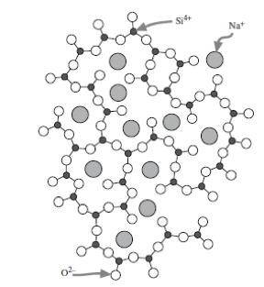
Reaction products Q-notation
Problem: how to define structure?
  3D network
  Cross-link density depends on ratio Si/R
  with R= cation (Na, K, Ca,…)
  Nomenclature polysilixo etc: based on linear polymers
  = inappropriate for 3D networks where every Al is surrounded by 4 Si and every Si by probably 3-4 other tetrahedra (Si or Al).
Q notation:
Q⁰= monomer (linked to no other tetrahedrons)
Q¹= dimer (linked to one) or end group
Q²= linked to 2
etc

Slide 16
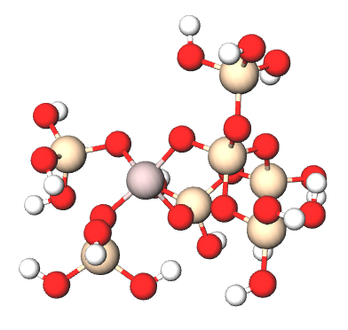
Reaction products Q-notation
Problem: how to define structure?
  3D network
  Cross-link density depends on ratio Si/R
  with R= cation (Na, K, Ca,…)
Q notation:
Q⁰= monomer (linked to no other tetrahedrons)
Q¹= dimer (linked to one)
Q²= linked to 2
etc
Inorganic polymer:
Si mainly Q⁴(mAl)
  m depends on ratio Si/Al
For Al: q⁴(4Si)

Slide 17
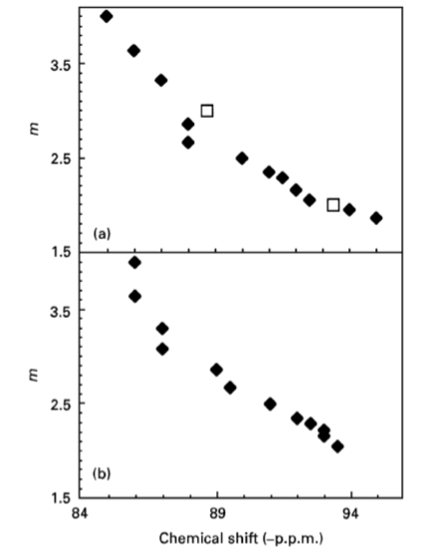
Reaction products Si/Al ratio
Si mainly Q⁴(mAl)
m depends on ratio Si/Al
m = Al surrounding SiO₄
Even distribution of Al over Si
(no diffusion control)
Si Q³ = 1 Si-OH or Si-O⁻
²⁹Si NMR

Slide 18
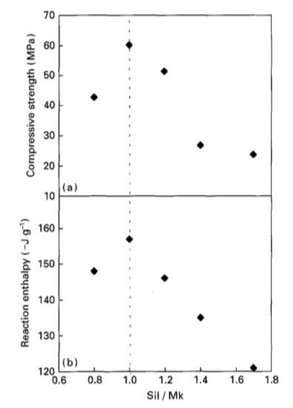
Reaction products Na/Al
Important: Na/Al = 1
Take care for mechanical testing:
amount of water in samples = constant
BUT never 100% reaction
THUS in practice Na/Al < 1
And large particles?
And max strength not needed?
Mechanical testing
Calorimetry
J. Mater Sc 1996 31 p 71

Slide 19
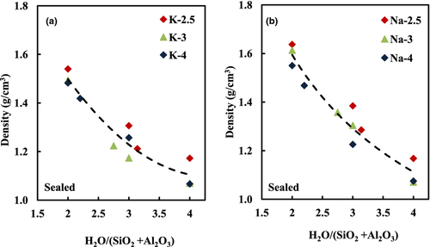
Properties of products
Influence H₂0 content
Journal of the American Ceramic Society, Volume: 95, Issue: 7, Pages: 2169-2177, First published: 10 April 2012, DOI: (10.1111/j.1551-2916.2012.05184.x)
Notes:
Density of (a) K‐ and (b) Na‐activated geopolymers with SiO2/Al2O3 ratios of 2.5 to 4 as a function of the initial water content (i.e., H2O/(SiO2 + Al2O3)) after curing and aging for 21 days.
IF THIS IMAGE HAS BEEN PROVIDED BY OR IS OWNED BY A THIRD PARTY, AS INDICATED IN THE CAPTION LINE, THEN FURTHER PERMISSION MAY BE NEEDED BEFORE ANY FURTHER USE. PLEASE CONTACT WILEY'S PERMISSIONS DEPARTMENT ON PERMISSIONS@WILEY.COM OR USE THE RIGHTSLINK SERVICE BY CLICKING ON THE 'REQUEST PERMISSIONS' LINK ACCOMPANYING THIS ARTICLE. WILEY OR AUTHOR OWNED IMAGES MAY BE USED FOR NON-COMMERCIAL PURPOSES, SUBJECT TO PROPER CITATION OF THE ARTICLE, AUTHOR, AND PUBLISHER.

Slide 20
Properties of products
Influence Si/Al
Si/Al=1.15
Si/Al=1.65
Colloids and Surfaces A: Physicochemical and Engineering Aspects, 269 (2005), P 47
Si/Al=2.25

Slide 21
Reaction rate
Influence Si/Al (repetition)
Reaction rate (DSC, heating at 5K/min; hermetic closed pans)
Comparison of DSC thermograms for the reaction of Mk with
Na-silicate Na₂O.sSiO₂ solutions with variable s (water=10.0): s = (a) 1.0, (b) 1.4, (c) 1.6, (d) 1.7, (e) 1.9, (f ) 2.3 and (g) K-Sil with s=1.4.

Slide 22
Properties of products
K of Na?
Construction and Building Materials 178 (2018) 453

Slide 23
High temperature properties
Si
Structure of IP comparable to glass.
Main difference:
  Physico-chemically bound water
  Water around cations
  (Si)-OH groups
What happens upon heating?
  Water evaporates, SiOH disappears
Tg ?
Na⁺
Al
Al
O²⁻

Slide 24
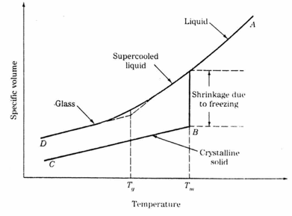
High temperature properties Tg
Tg: volume-T diagram
Tg= from solid to rubbery behavior
Influence plasticizers
Influence cations, K, Na,…
Influence Al/Si

Slide 25
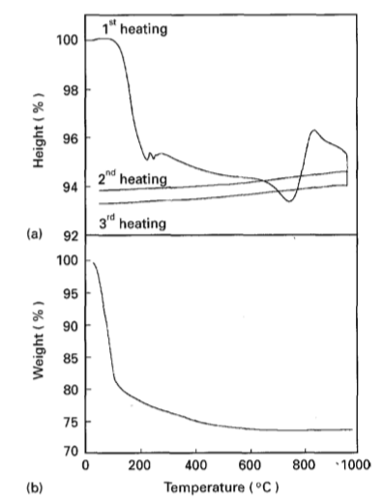
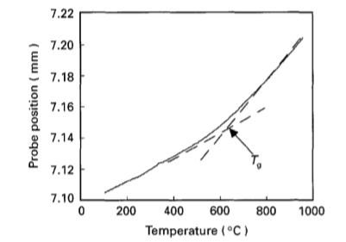
High temperature properties: TMA
length
mass
How to measure Tg?
Difficulties: everything which is happening during first heating and can confuse you
2nd heating: OK or not?
K higher Tg than Na

Slide 26
High temperature transformations
With K or Cs: higher T stability (Kriven)
Construction and Building Materials
Volume 190, 30 (2018), Pages 108

Slide 27
Strength evolution
Construction and Building Materials
Volume 190, 30 (2018), Pages 108

Slide 28
Broadening to Ca, Fe containing precursors the real world
Precursors: Fly ash (FA); GGBFS; other slags from metallurgy, red mud,…
example
 | Fly ash | GGBFS
SiO₂ | 50 | 32
Al₂O₃ | 28 | 14
Fe₂O₃ | 13 | 0.6
CaO | 1.8 | 43
MgO | 0.9 | 3.9
SO₃ | 0.4 | 4.6
Construction and Building Materials 66 (2014) 163–171
BUT composition not same for any FA, composition not constant

Slide 29
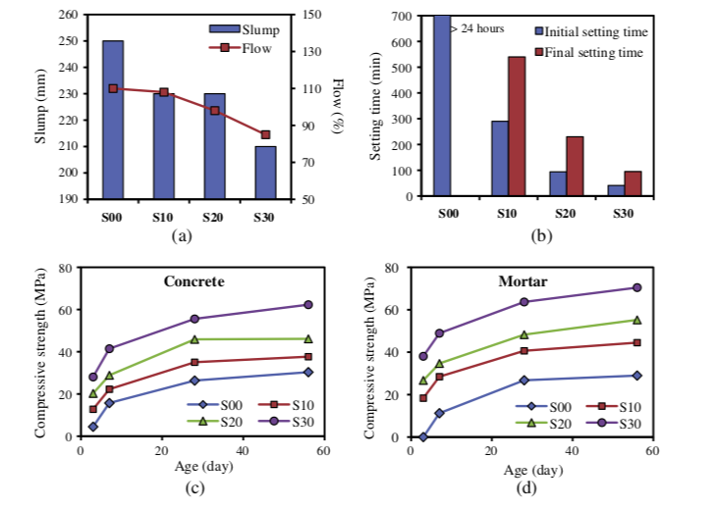
FA+GGBFS: replacement of FA by GGBFS
X% FA + 0-30% GGBFS
Water/solid constant
Construction and Building Materials 66 (2014) 163–171

Slide 30
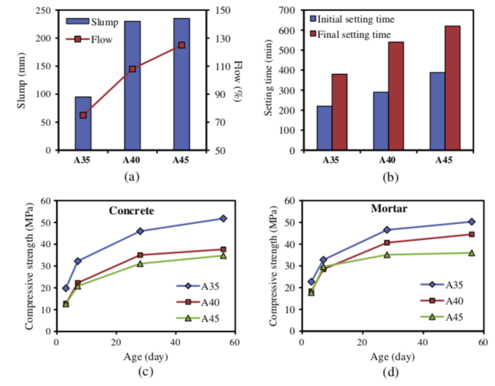
FA+GGBFS
90% FA + 10% GGBFS
Na2O/SiO2
= 0.11 A35
= 0.13 A45
Water content not constant
Construction and Building Materials 66 (2014) 163–171

Slide 31
Often encountered errors
Change the molarity of NaOH solution
But you make one silicate solution. Complete composition is important
If then you make a series, the water content is probably not constant thus the mechanical properties also depend on the water content.

Slide 32
Durability
Compressive strength of AASC and OPCC, in (A) 10% Na₂SO₄ solution, (B) 10% MgSO₄ solution. ACS-X represents AASC mixes with X (% by volume) of fine aggregates replaced with copper slag J. Cleaner Prod., 112 (2016), pp. 837-844

Slide 33
Durability
Alkali-silica reaction in various geopolymer and OPC mortars under accelerated condition (1 M NaOH) at 80 °C
So don’t generalize
Construction and Building Materials
85, (2015) Pages 78-90

Slide 34
Environmental impact
CO₂ emission reduction?
  Depends on raw materials
  Problem: production of silicate solution
Reduction of virgin material use?
  Not if metakaolinite, volcanic ash,… is used
End of life?
  Limited research

Slide 35
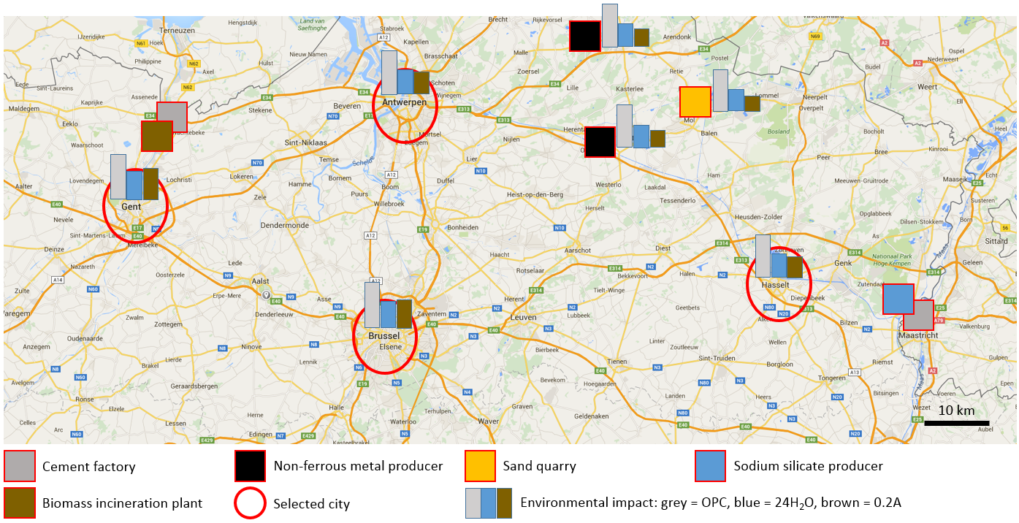
Environmental impact
If raw materials correclty selected:
Huge reduction environmental impact
(A. Peys)
Compressive strength tunable 20-100 MPa

Slide 36
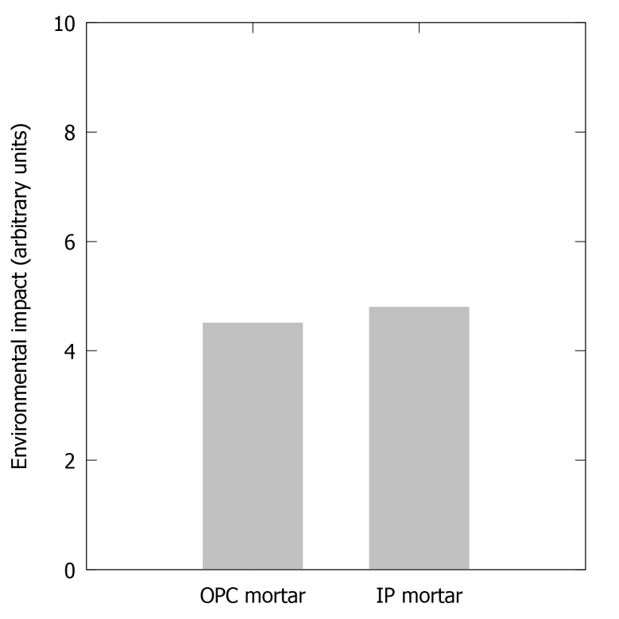
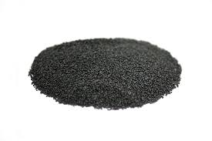
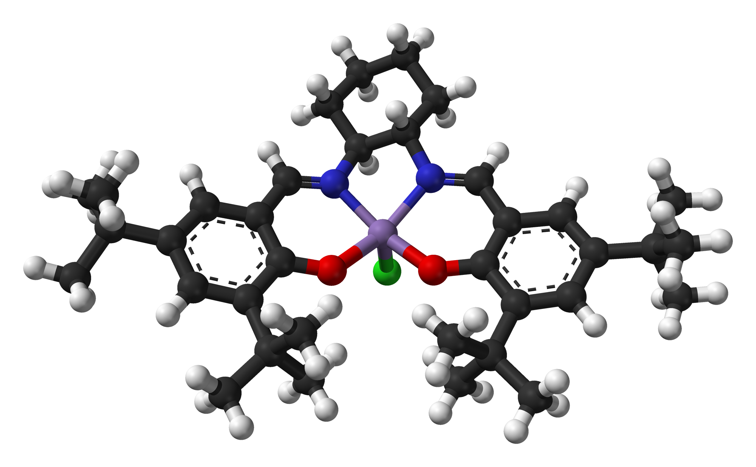
Envionmental impact compared to OPC
Comparison might not be so positive…
Solutions?
Recycle slag
Try to reduce impact of existing materials (e.g. cement):
  Use not-valorised slag: Iron-rich slag (more knowledge needed)
  Identify and solve main impact generators

Slide 37
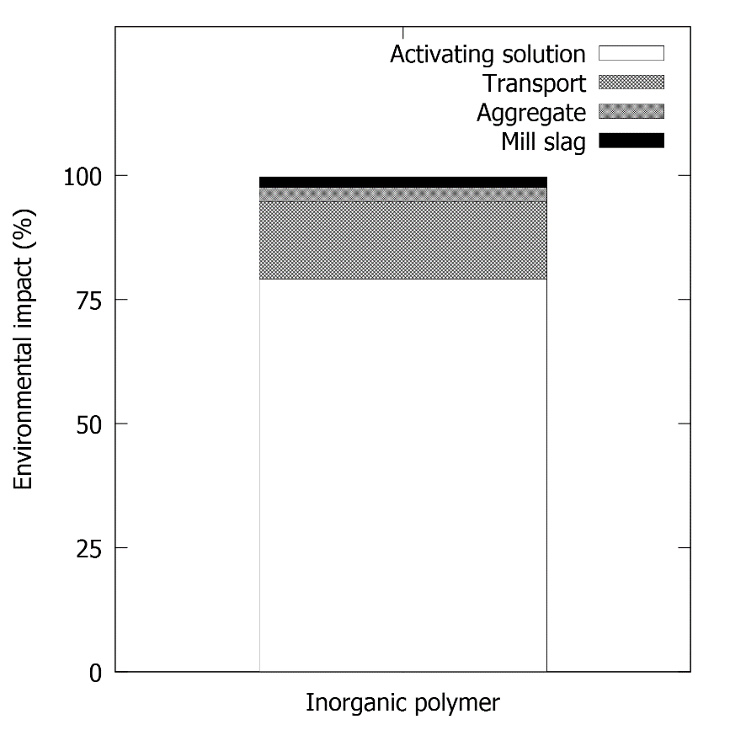
Impact reduction?
Reduce sodium silicate activating solution
  Dilute solution
  Alternative activator: biomass ash
Activating solution .

Slide 38
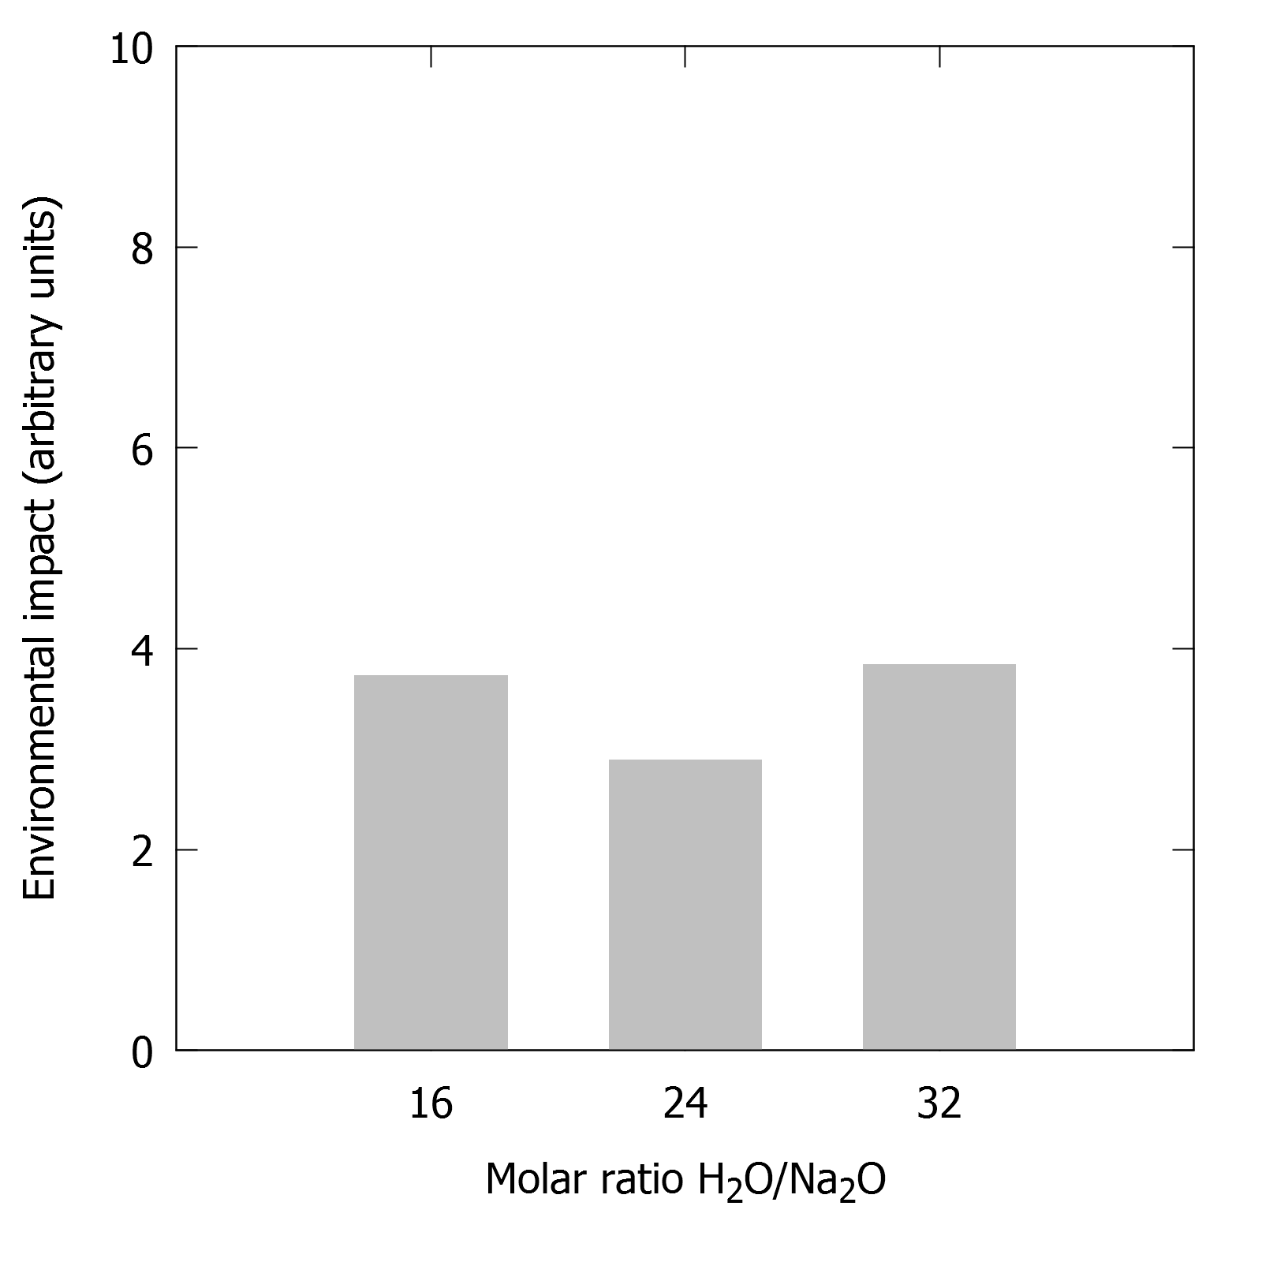
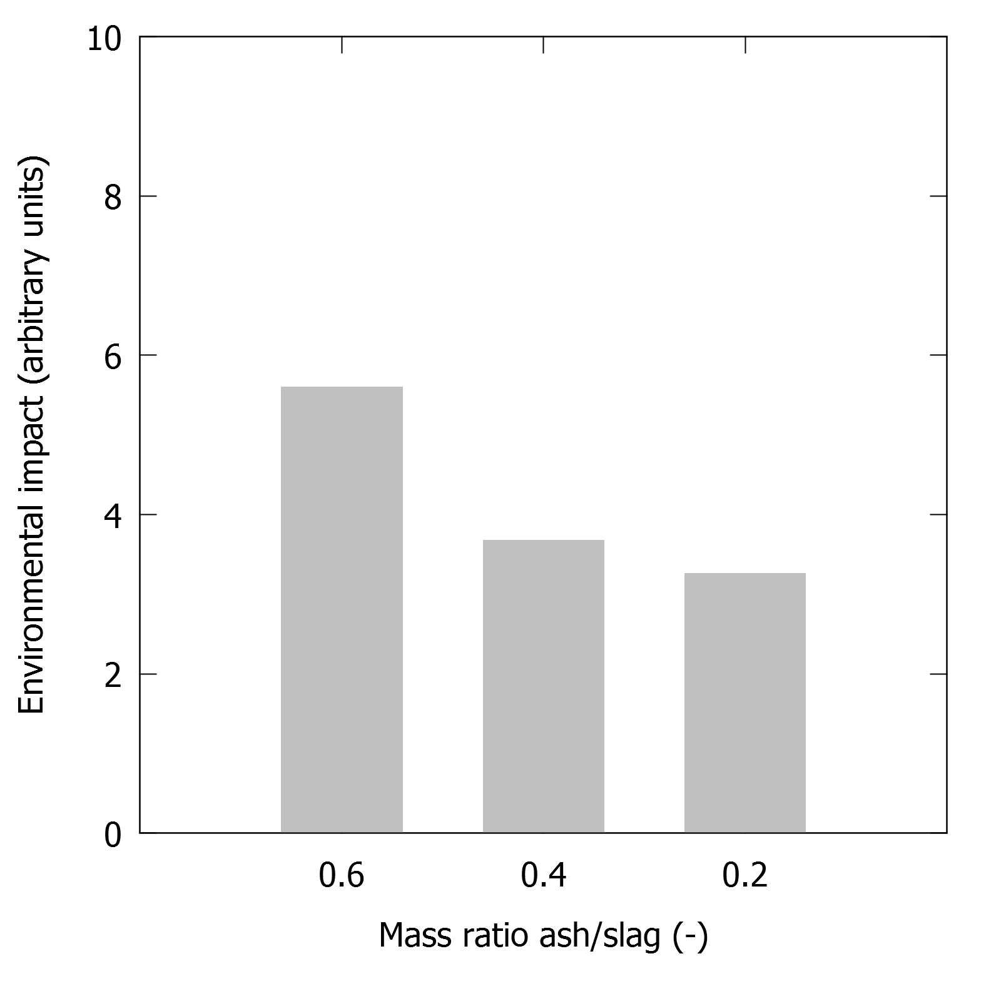
Impact reduction?
Reduce sodium silicate activating solution
  Dilute solution
  Alternative activator: biomass ash

Slide 39
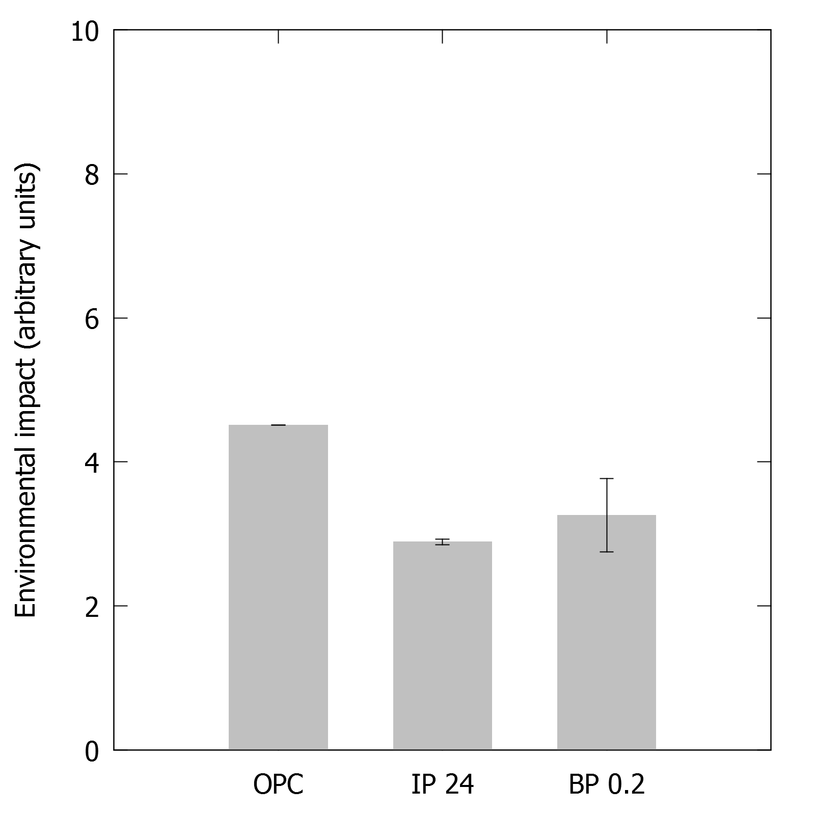
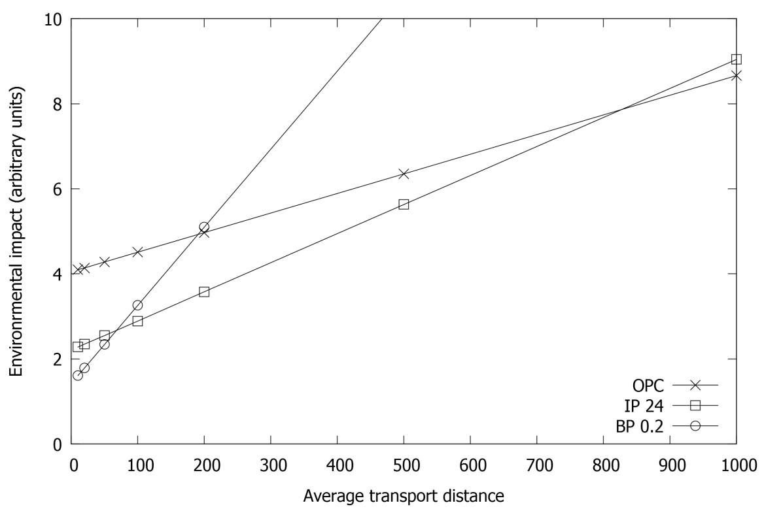
Impact reduction!
Environmental impact reduction with respect to OPC mortar
  Dilution: 36%
  Biomass ash activation: 28%
Highly dependent on transport distance! (truck)
100 km

Slide 40
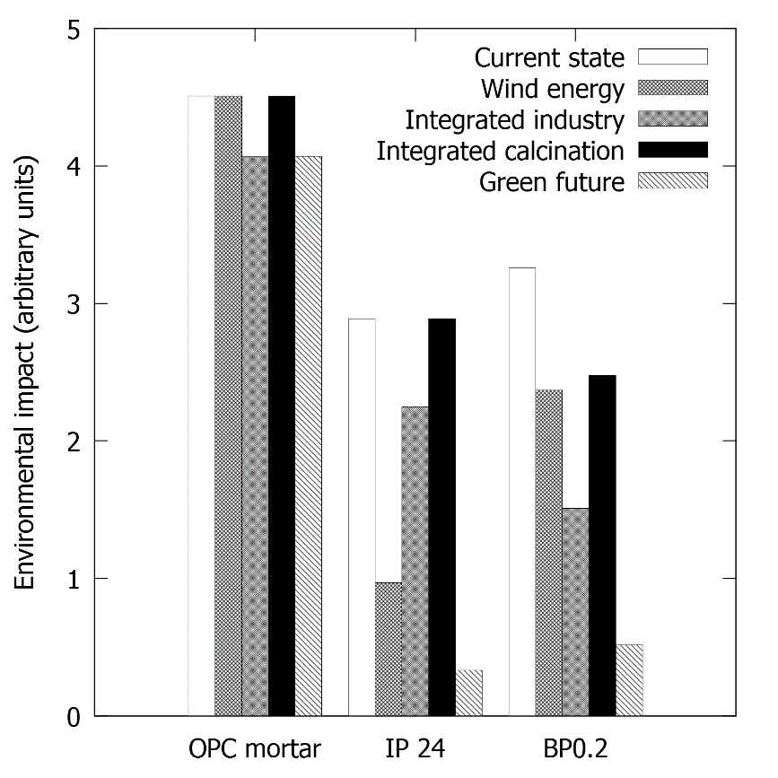
More impact reduction!
LCA databases: conservative data and processes
Include green energy, short transport distances (blue economy):

Slide 41
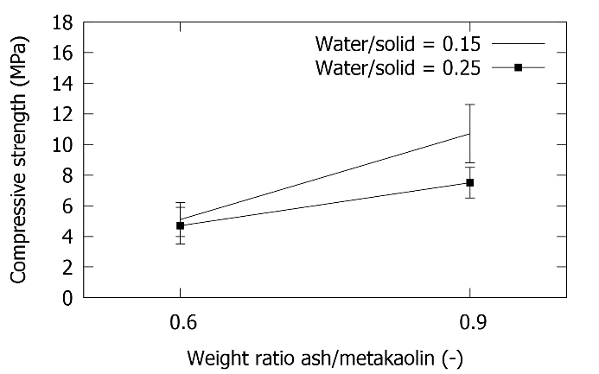
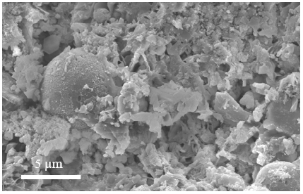
Environmental impact decrease by biomass ash activation
Industrial biomass ashes as alkaline activator (system proven using “purer” maize ashes) A. Peys Waste and Biomass Valorization, 2018, 9(6), 879
For industrial ashes and slag, lower strength observed:

Slide 42
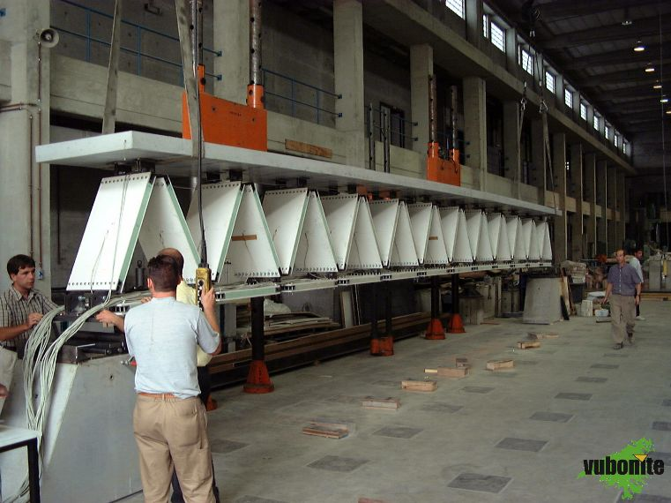
Environmental impact decrease by using less material
Geopolymers (alkaline)
Phosphate cements (acid)
Textile reinforced cementitious composites for a high-performance, fire-resistant, sustainable building system
Sandwich panel
SBO CECOMSTRUCT
MEMC
FYSC
MTM
WTCB
3D weaving
Saving on material
Re-use of waste materials
Notes:
A common characteristic of FYSC’s activities is the attention to materials for a more sustainable society.
As an example, low CO₂ cements are being developed for construction applications, in cooperation with the MEMC department and other partners.

Slide 43
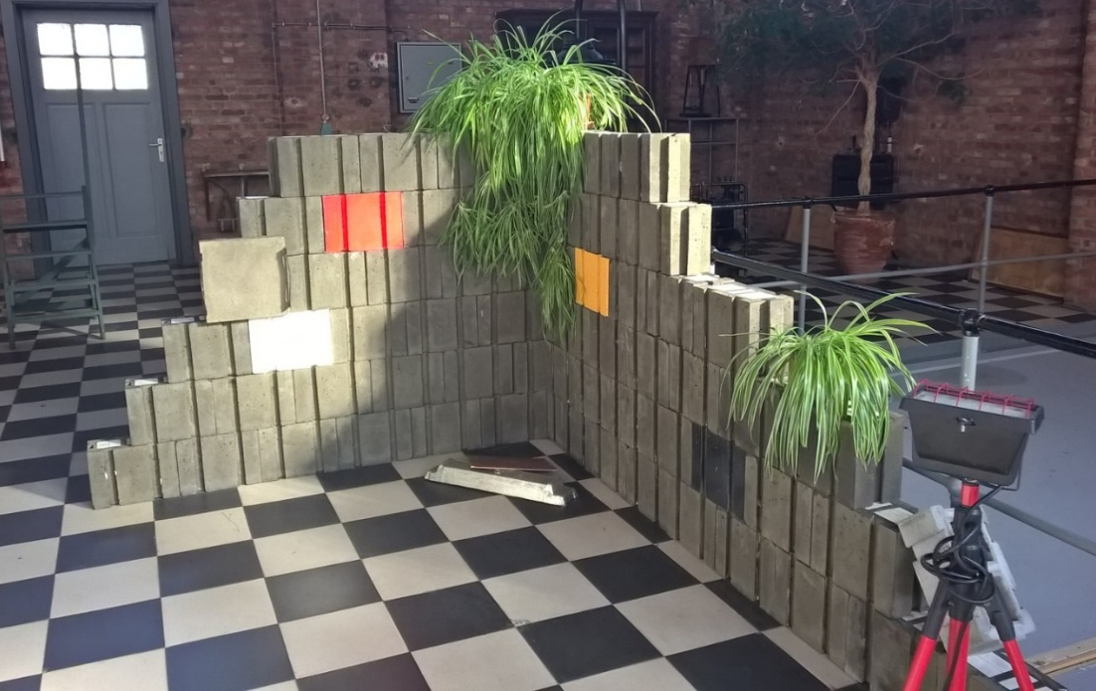
Recycling options?
Incomplete reaction
  Still some reactive material left
  Only limited number of cycles
Remains to be studied

Slide 44
Conclusions
There is not something like ‘THE geopolymer’
Properties depend largely on
  Composition (precursor, cation content, …)
  Amorphous fraction
  Curing conditions
High temperature resistance: superior to OPC
Environmental impact
  Not necessarily better
  Impact can be reduced

